Slide 1
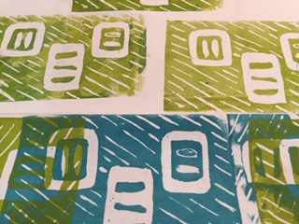

Design your own fabric
April 2019
Chattanooga Modern Quilt Guild Presented by Ann Hurley

Slide 2
Design your own fabric outline
Principles of design- quick overview
Lets talk pattern and motif ….
Can you repeat that, please?
How does my design look in repeat?
Printing methods
Hand printed- via stencil, screen, block print, stamped
Demo – Kelly Spell
Mechanical- Digital, i.e., Spoon flower
Spoonflower, demo – Karen Downer

Slide 3
7 Principles of design
Balance symmetrical - (formal Balance)- when each half of the design is identical asymmetrical – (informal balance)- when each side of a design is not identical but somewhat similar radial – when there is an equal pattern movement
Emphasis Unity
Movement Contrast
Variety Pattern

Slide 4
Pattern, motif and color
Developing a pattern can be as simple as a single motif or it can be an all over intricate design.
Color combination is important
Review from Durinda’s color presentation
primary colors- red, blue, yellow
complimentary colors- those opposite each other on the color wheel
analogous colors- those adjacent to each other on the colors wheel, ie, blues, teals, greens or red, orange and yellow

Slide 5
2 Printing techniques
Hand print
Digital print
May be done with wood blocks, stencils, stamps or screen printed
Use padded table for best results
Use textile paints
Always heat set for best results
Spoon flower digital custom printing process
Totally customizable, in both pattern and color
Website give access to thousands of patterns and can be sorted by style, era, design trend or color family

Slide 6
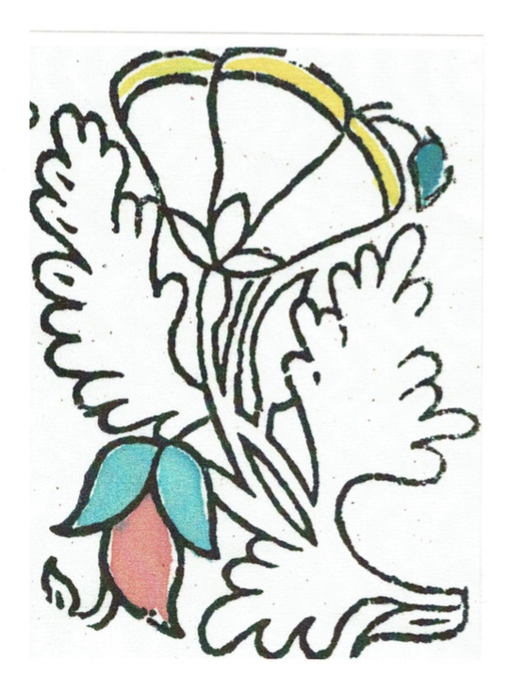

Pattern repeats
First lets look at various types of repeats
Individual Motif- art noveau style hand printed wood block

Slide 7
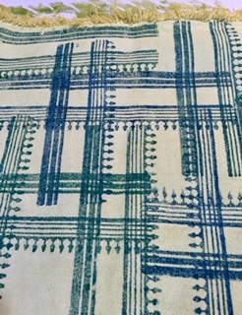
Screen printed- Block printed
Show various fabric samples with different repeats
Method: Hand printed

Slide 8
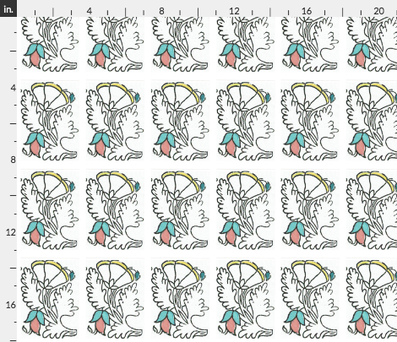
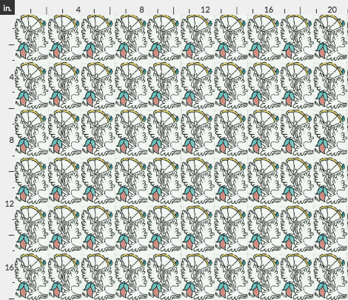
My same print Digitally reproduced on Spoon flower web site
Straight Match –
pattern is duplicated equally in both vertical and horizontal directions

Slide 9
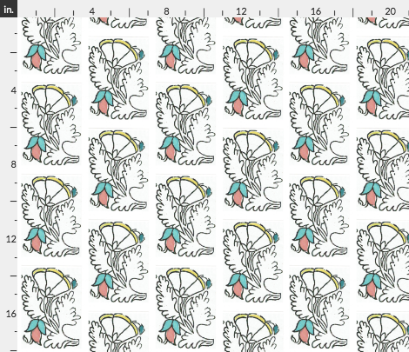
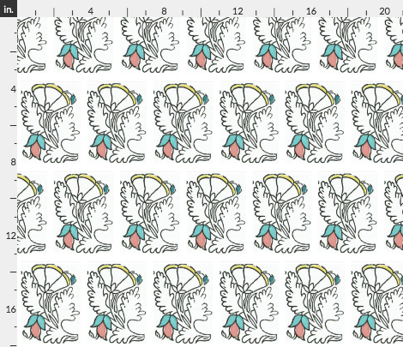
Half drop repeat-
is off set in a vertical direction
Half brick Repeat-
is staggered or offset horizontal

Slide 10
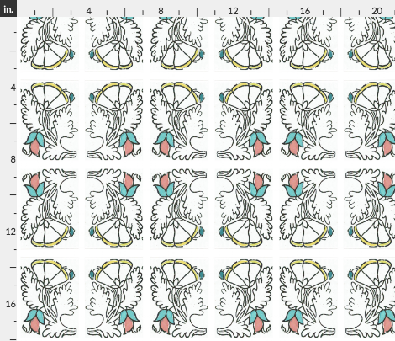
Mirror Repeat

Slide 11
Easy steps Spoon flower digital printing
Set up your free account
With email and create password
Go to Design tab
*** its best to have your design or photo scanned and saved in a jpg format
Hit upload design, then confirm
select the repeat choice and decide if you want a sample, fat quarter
or yard goods.
There are 22 base fabrics available… from cotton, poplin, twill, gauze,
crepe de chine, Linen, lycra, denim and yes, even Minky!
Process the order, with credit card and select shipping.
Wait for your shipment to arrive!!

Slide 12
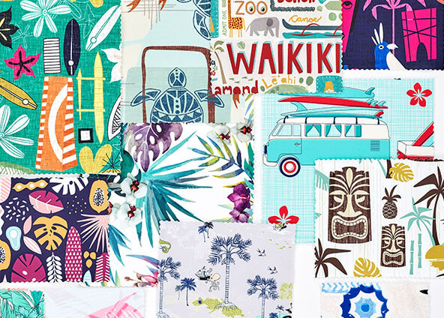
Multiple pattern options
Beach Themed prints from Spoon flower

